Slide 1
IBM CAPSTONE PROJECT Housing prices in Chennai
By Uma Sankar G

Slide 2
Outline
Introduction
Business Problem
Data
Strategy for problem solving
Data Cleaning
Visualization
Foursquare API
Data Transformation

Slide 3
Elbow method
KMeans Clustering
Clustered points
Conclusion

Slide 4
Introduction
Chennai is the capital of Indian state of Tamil Nadu. It is the one of the largest cultural, economic and educational centres of south India.
It is also called Detroit of South Asia due to large number of automobile industries.

Slide 5
Business Problem
We are going to use Kaggle dataset https://www.kaggle.com/sonukiller99/indian-house-price-combined
to determine affordable housing for in the price range up to Rs. 100000
Clustering neighbourhoods based on venues.

Slide 6
Data
We will be using data set from https://www.kaggle.com/sonukiller99/indian-house-price-combined.
It contains data of India’s metropolitan cities consisting of price of each neighbourhood area with details containing location, plot area, number of bedrooms, availability of lift, swimming pool, etc. are mentioned along with the price of the house.
We will use Foursquare API (https://api.foursquare.com) to explore various revenues near each locality in Chennai

Slide 7
Strategy for problem solving
We will collect the housing data from Kaggle set.
We will explore venues for each locality using Foursquare API.
We will merge venues with the housing data from Kaggle set.
We will find best localities for affordable housing.
With Folium library we will analyse the results.

Slide 8
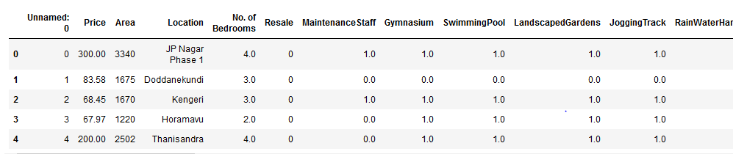
Data Cleaning
Download the Kaggle data set and select city Chennai as a pandas DataFrame

Slide 9
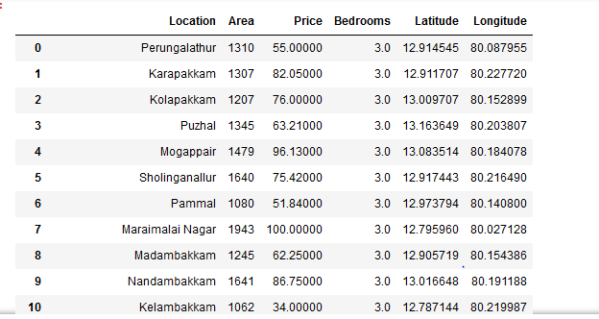
Data Cleaning
Drop the columns that are irrelevant and set the No of Bedrooms to 3 and Price to equal or lesser than 100 lakhs.

Slide 10
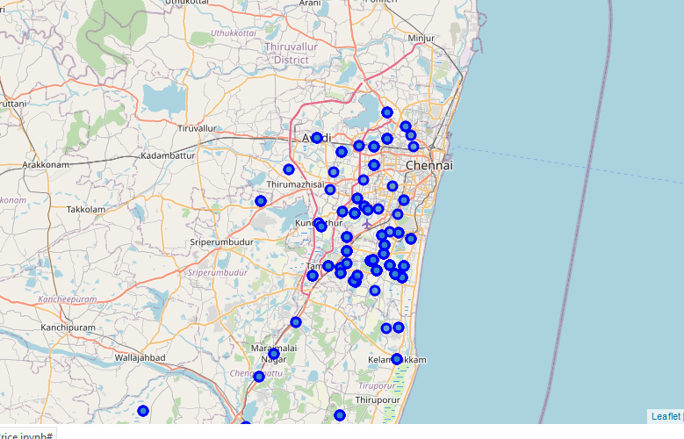
Visualization
Cluster the areas using Folium package.

Slide 11
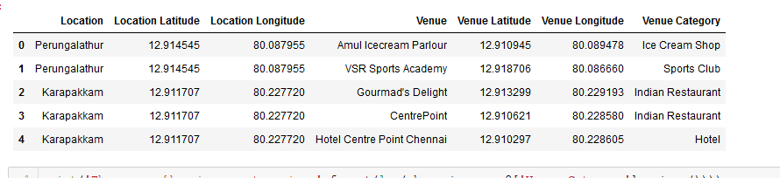
Foursquare API
Extract the venues using the Foursquare API from the location with its latitude and longitudes and find the venues name with its latitudes and longitudes

Slide 12
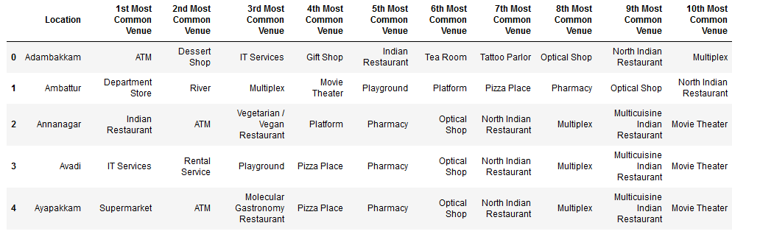
Data Transformation
Top ten revenues provided by Foursquare API for each locality.

Slide 13
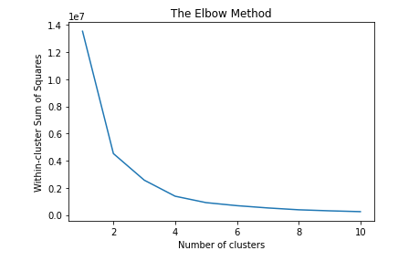
Elbow method
Use the elbow method to find the number of clusters to run the KMeans clustering. As per the elbow method the at K = 6 is the optimal point the data’s can be clustered.

Slide 14
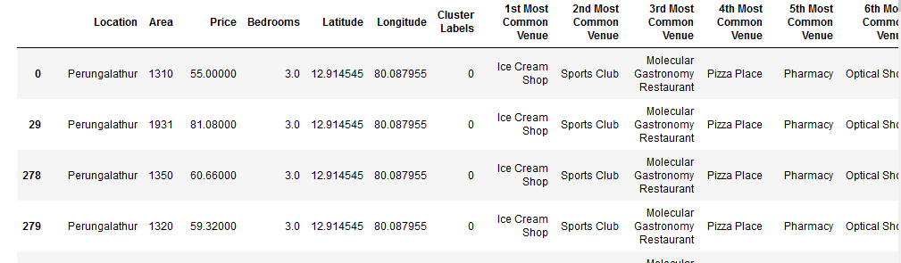
KMeans Clustering
Using the k value find the clusters for the localities.

Slide 15
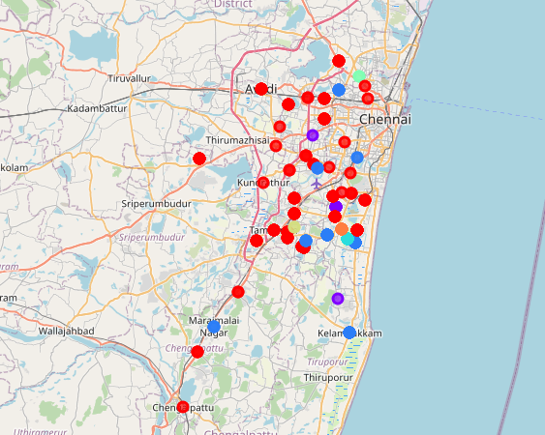
Clustered points

Slide 16
Conclusion
In Cluster 0, there are lot of ice cream shops and restaurants. There is a pharmacy. In some place there is train station will be useful for daily commuters. The
In Cluster 1, there are lot of Grocery shops and restaurants suitable for all kinds of people
In Cluster 2, there are lot of restaurants.
In Cluster 3, the most frequent place used is Pizza shop.
In Cluster 4, the Smoke shop is the most frequent place.
In Cluster 5, the most frequent place is lake
In Cluster 6, the place is nearer to farmers market.

Slide 17
Conclusion
I will recommend Cluster 6 because it has Farmers market, Pharmacy, Multiplex and Movie Theater. Also the price of the housing is affordable. With time the value of the house can increase.

